Slide 1

Project Title: Implementing YOLOv8 and Face Transformer Models for Advanced Face Recognition Domain: Pattern Recognition and Neural Networks
First Review
Course Code: CS7510
Course Title: Project 1
Register Number: 23MSP3068
Name: Dharshani A.
Date: 23-02-2024

Slide 2
Problem Statement
Face recognition presents a complex yet critical task in fields ranging from security to entertainment and social networking.
Although current models have made significant strides, there's still potential for enhancement in accuracy, robustness, and operational efficiency.
The project intends to investigate the capabilities of YOLOv8 and Transformer models to improve face recognition technology.
This research will focus on creating a model capable of precisely recognizing faces in a variety of scenarios, which include fluctuating lighting conditions, diverse angles, and different facial expressions.
The success of the developed model will be assessed using relevant performance metrics and benchmarked against existing face recognition models.

Slide 3
Objectives
To evaluate the current limitations of face recognition technology and identify areas where YOLOv8 and Transformer models might offer improvements.
To implement and test the YOLOv8 and Transformer models specifically for the task of face recognition, with a focus on handling various environmental variables.
To enhance the accuracy and robustness of face recognition systems, making them more reliable under diverse and challenging conditions.
To increase the efficiency of face recognition systems, aiming for a faster processing time which is crucial for real-time applications.
To conduct a comprehensive comparison of the proposed models against existing state-of-the-art face recognition models, using standard evaluation metrics.

Slide 4
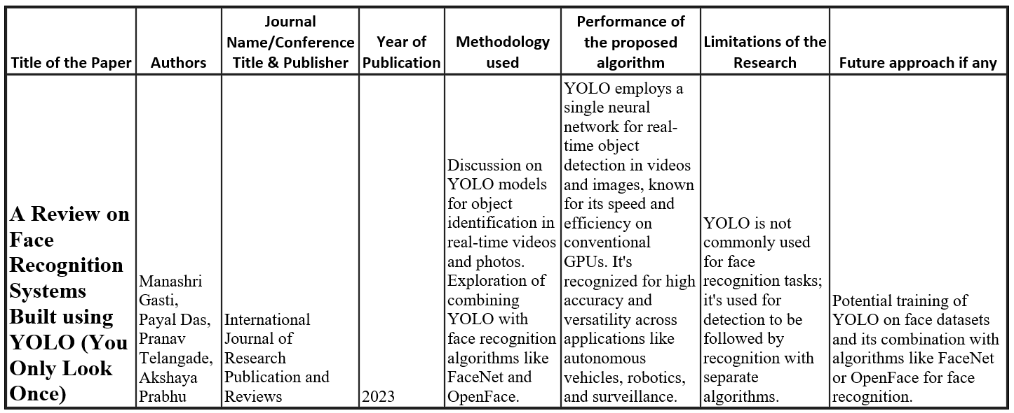
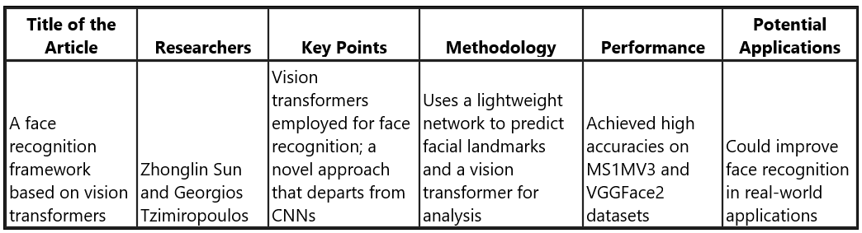
Review of Related Literature
Points to be taken into consideration :
Project could utilize YOLOv8 for fast face detection in real-time.
Incorporate Transformer models for in-depth facial feature extraction.
Training involves large, annotated datasets to elevate recognition precision.
Combines YOLOv8's detection speed with Transformer models' data processing for improved performance under diverse conditions.

Slide 5

Dataset
Source of the Dataset: @bts.bighitofficial on Instagram
No. of Observations: 50 images * 7 members
Total Observations after Augmentation: 16800 = 50*7*24*2

Slide 6
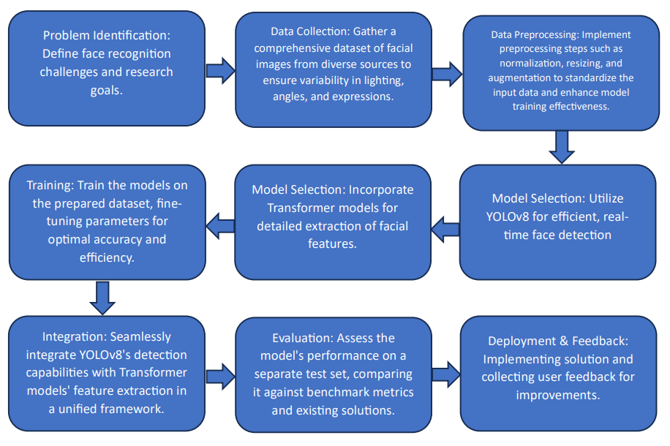
Proposed Methodology

Slide 7
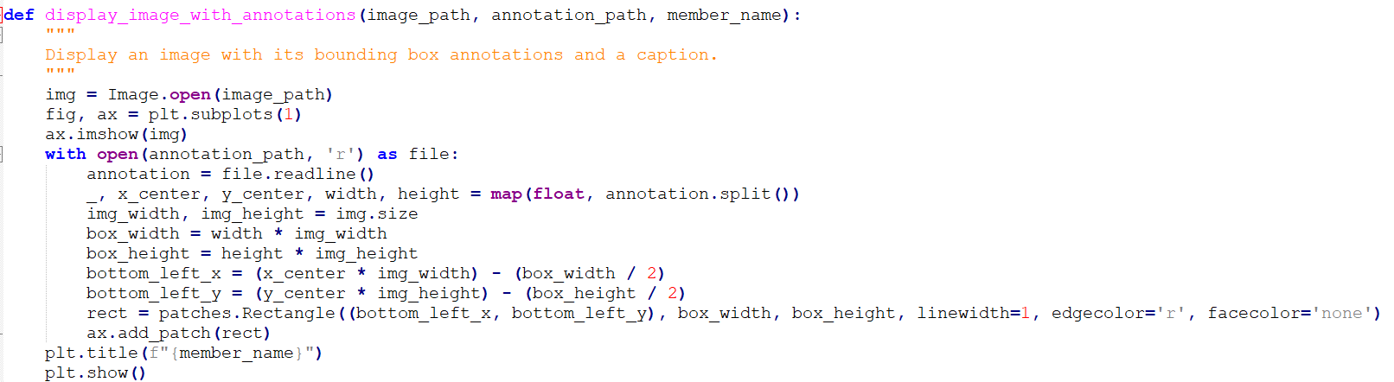
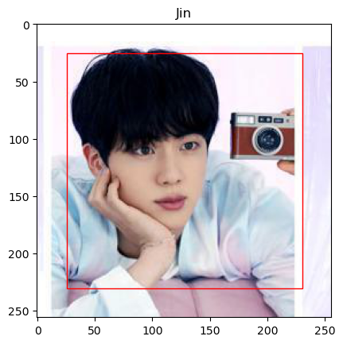
Exploratory Data Analysis

Slide 8
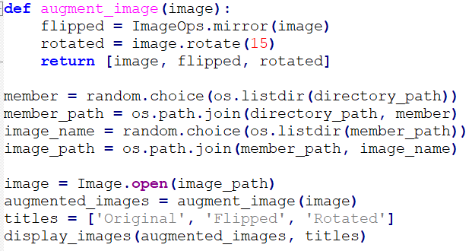
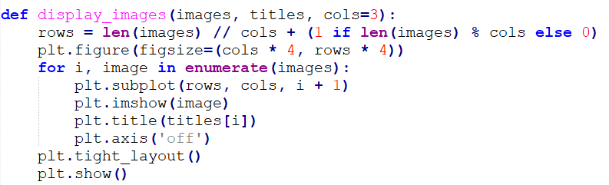
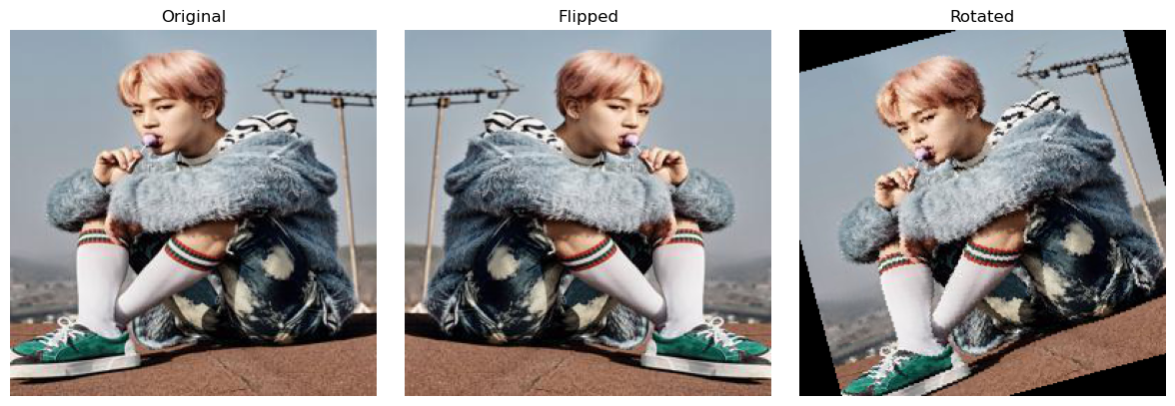
Exploratory Data Analysis

Slide 9
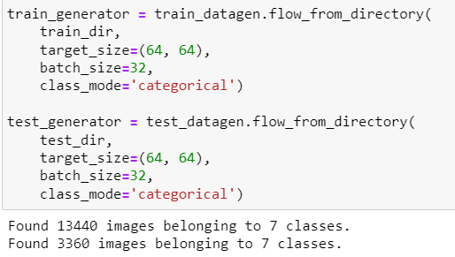
Exploratory Data Analysis
Train-Test Split for 16800 images
Test size = 0.2 = 20%
Train Data = 40*7*24*2
Test Data = 10*7*24*2

Slide 10
Next Step of Research Focus
Diversify dataset with more variations in lighting, angles, and expressions.
Optimize YOLOv8 and Transformer models for faster real-time performance.
Research novel model fusion techniques integrating YOLOv8 and Transformers.
Explore ethical and privacy implications of face recognition technology.
Tailor model for specific applications: security, entertainment, social media.
Extend methodologies to other computer vision tasks beyond face recognition.

Slide 11
Conclusion
Collected data from @bts.bighitofficial on Instagram
Augmented the dataset in order to prepare for model training and evaluation
Future steps include actual integration testing of YOLOv8 with Transformer models to assess performance improvements in varied conditions.

Slide 12
References : APA format
Manashri Gasti, Payal Das, Pranav Telangade, Akshaya Prabhu. (2023). A Review on Face Recognition Systems Built using YOLO (You Only Look Once). https://ijrpr.com/uploads/V4ISSUE4/IJRPR11354.pdf
Dholakiya, P. (2023). Facial Emotion Detection Using YOLO v8. https://medium.com/@parthdholakiya180/facial-emotion-detection-using-yolo-v8-ec2983850014
Zhongyy. (2021). Face-Transformer. https://github.com/zhongyy/Face-Transformer
Yaoyao Zhong, Weihong Deng. (2021). Face Transformer for Recognition. https://arxiv.org/abs/2103.14803
Ingrid Fadelli. (2022). A face recognition framework based on vision transformers. https://techxplore.com/news/2022-12-recognition-framework-based-vision.html

